Slide 1
FPGA Internal Sensor Oscilloscope
Real-time monitoring using FPGA + ESP32 + Web Interface

Slide 2
Project Overview
Purpose: Visualize internal FPGA sensor data (Temp, VCCINT, VCCAUX, VCCBRAM) in real-time.
FPGA Side:
Artix-7 FPGA reads internal sensors through the XADC IP block.
Data selected via debounced buttons and sent over UART.
Simple heartbeat and LED indicators show system activity.
MCU Side (ESP32 with MicroPython):
Reads UART data frames from FPGA, parses them, and stores in a circular buffer.
Serves a minimal web interface accessible via Wi-Fi (STA or AP mode).
Provides live waveform visualization and statistics (frames, bad reads).
Significance: Combines FPGA design principles, MCU peripheral programming, and networked data visualization for embedded system monitoring.

Slide 3
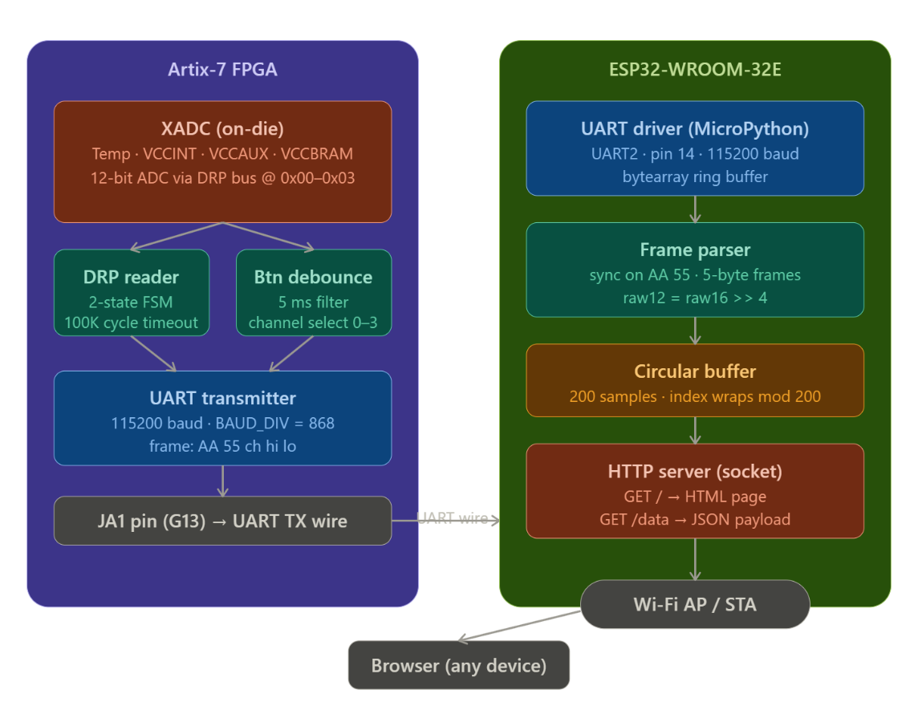
Architecture

Slide 4
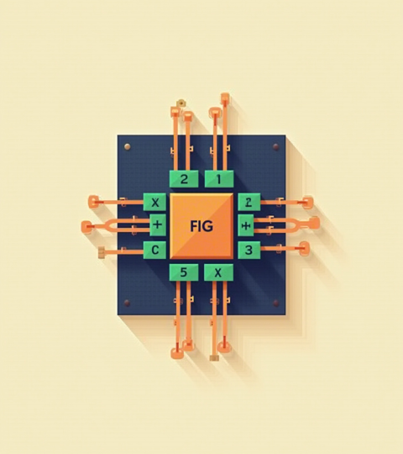
FPGA Architecture

Slide 5
Button Debounce & Channel Selection
Each of the four onboard buttons selects a sensor channel (0–3). A 5ms debounce filter — implemented as a counter that resets on any input change — ensures that mechanical bounce does not cause spurious channel switches. Only when the input remains stable for the full debounce period is the channel register updated. This feeds directly into the UART transmitter, which encodes the selected channel index into byte 2 of every outgoing frame.

Slide 6
FPGA Side
XADC hard IP reads Temperature, VCCINT, VCCAUX, VCCBRAM via DRP bus (addresses 0x00–0x03)
2-state FSM handles DRP read cycle with 100K-cycle watchdog timeout
UART transmitter: BAUD_DIV = 868, shifts 10-bit frame LSB-first at 115200 baud
XADC Conversion Formulas
The XADC returns 12-bit right-aligned values. To convert to physical units:
Temperature: T (°C) = (raw × 503.975) / 4096 − 273.15
Voltage rails (VCCINT, VCCAUX, VCCBRAM): V = raw × 3.0 / 4096
For example, a raw temperature value of 2508 corresponds to approximately 35.6°C, consistent with a room-temperature FPGA at light load.

Slide 7
VCCBRAM = 0 Explanation
VCCBRAM consistently returns a raw value of 0.
This is a known limitation: the VCCBRAM channel must be explicitly enabled in the XADC IP wizard's sequencer configuration.
In this design it was left disabled, so the DRP read at address 0x06 returns 0.
This does not affect the other three channels, which operate correctly. A fix would require re-generating the XADC IP with VCCBRAM enabled in the sequencer.

Slide 8
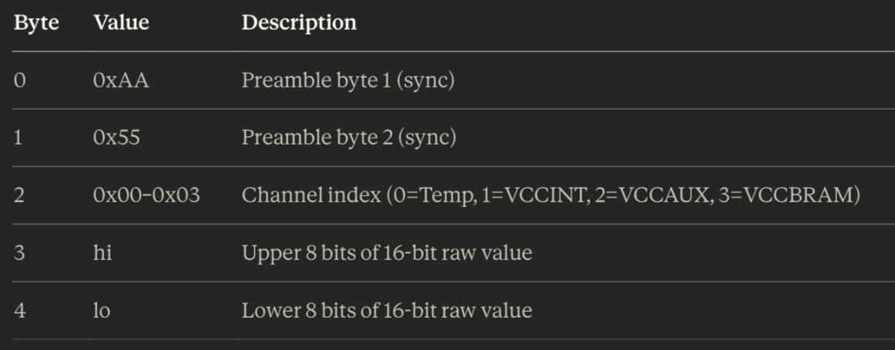
Frame Format
Each transmission consists of a 5-byte UART frame with the following structure:
The ESP32 syncs on the 0xAA 0x55 preamble and reconstructs the 12-bit sample as raw12 = (hi << 8 | lo) >> 4.

Slide 9
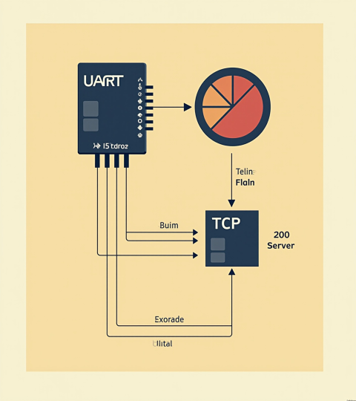
MCU side
UART receiver parses 5-byte frames, extracts 12-bit sample via raw16 >>4
200-sample circular buffer, index wraps with % 200
Raw TCP socket HTTP server — GET / returns page, GET /data returns JSON
Rxbuf parser correctly handles partial frames across multiple reads, the circular buffer of 200 samples , and the 100ms polling interval

Slide 10
Why Raw TCP Instead of asyncio?
The HTTP server is implemented using a raw blocking TCP socket rather than MicroPython's asyncio framework.
This was a deliberate design choice: since the ESP32 serves a single client polling at 100ms intervals, the added complexity of asynchronous coroutines provides no practical benefit. The synchronous model is simpler, easier to debug, and sufficient for this use case.

Slide 11
Conclusions + demo
This project successfully demonstrates a complete embedded data acquisition pipeline: from on-chip analog sensing via the XADC hard IP, through a deterministic UART link, to a live web-based oscilloscope accessible over Wi-Fi.
All three active channels — Temperature, VCCINT, and VCCAUX — return physically consistent values confirmed against expected operating ranges. VCCBRAM returns 0 due to the channel not being enabled in the XADC IP sequencer; this is understood and would be resolved by regenerating the IP with the correct sequencer settings.
Possible extensions include: converting raw values to physical units directly on the FPGA before transmission, adding multi-client support on the ESP32, or triggering captures on threshold crossings rather than continuous polling.

Slide 12
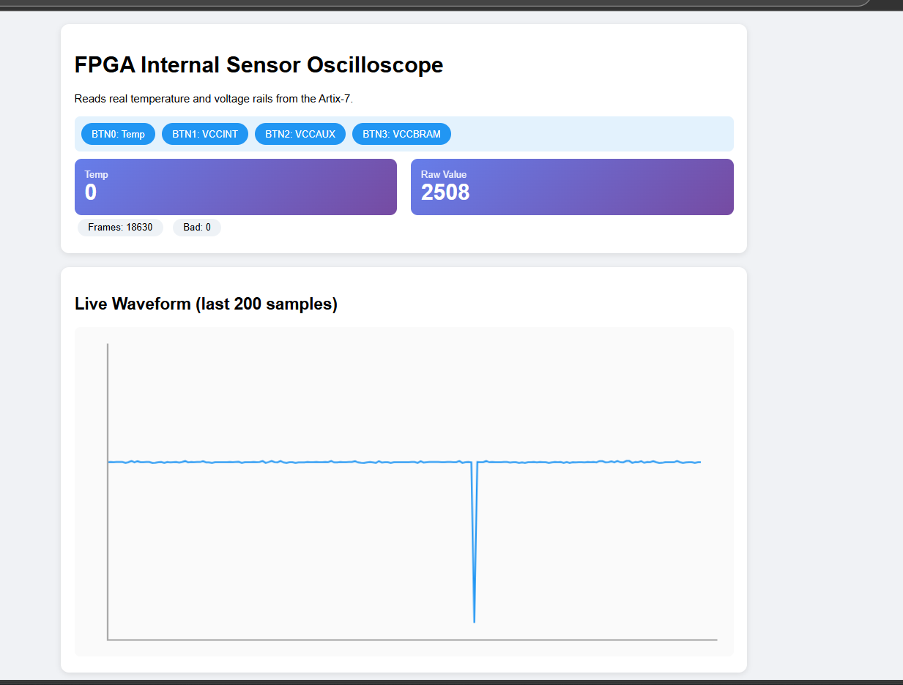

Slide 13
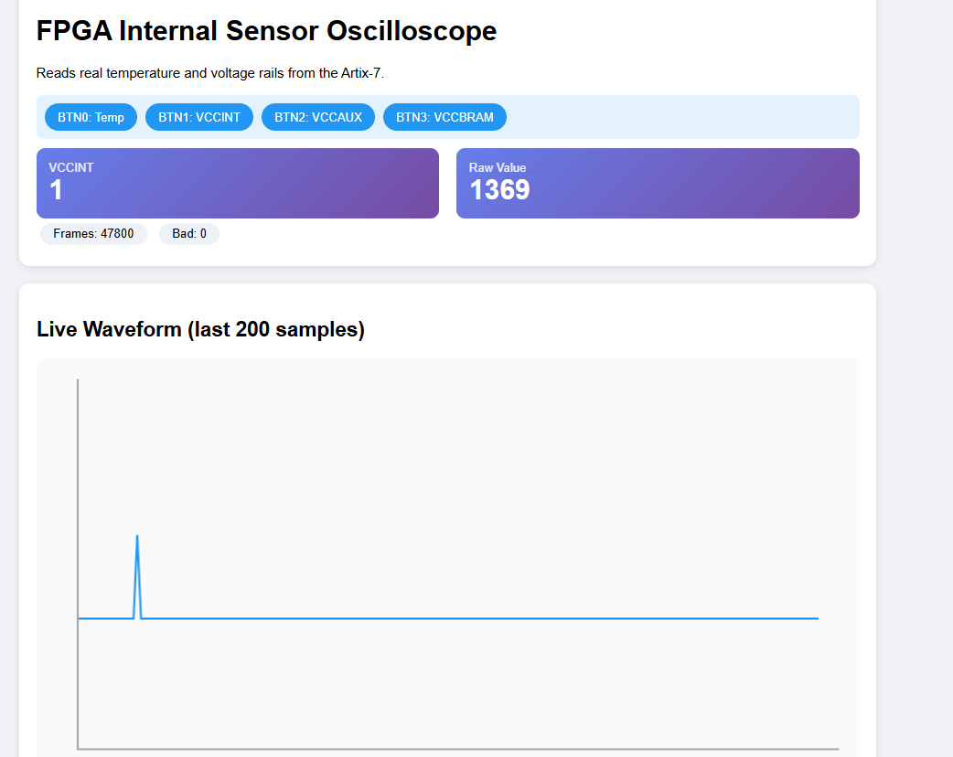

Slide 14
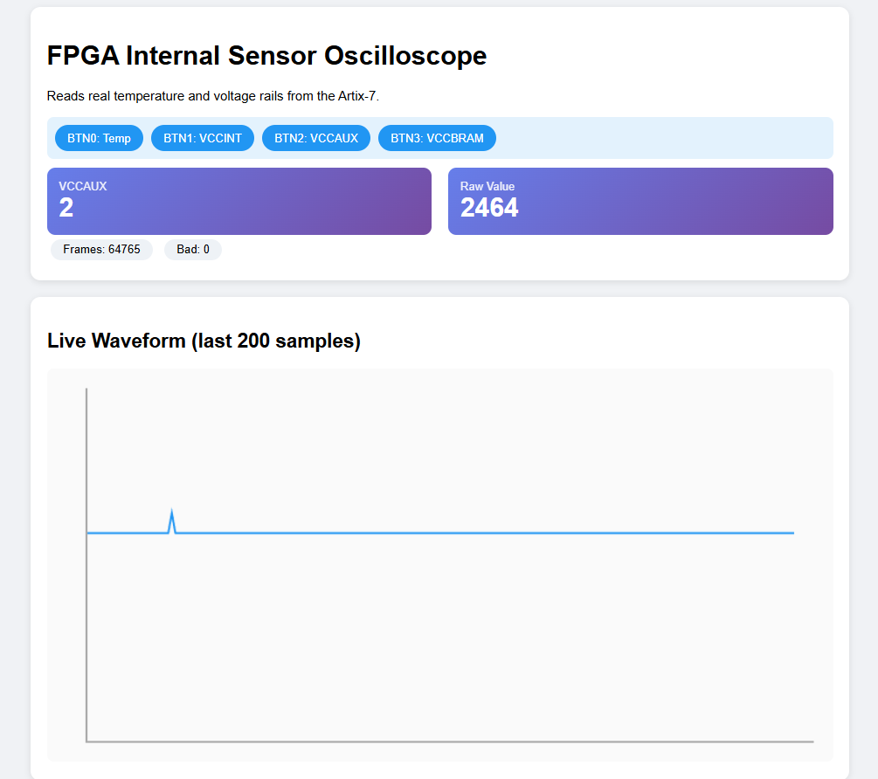

Slide 15
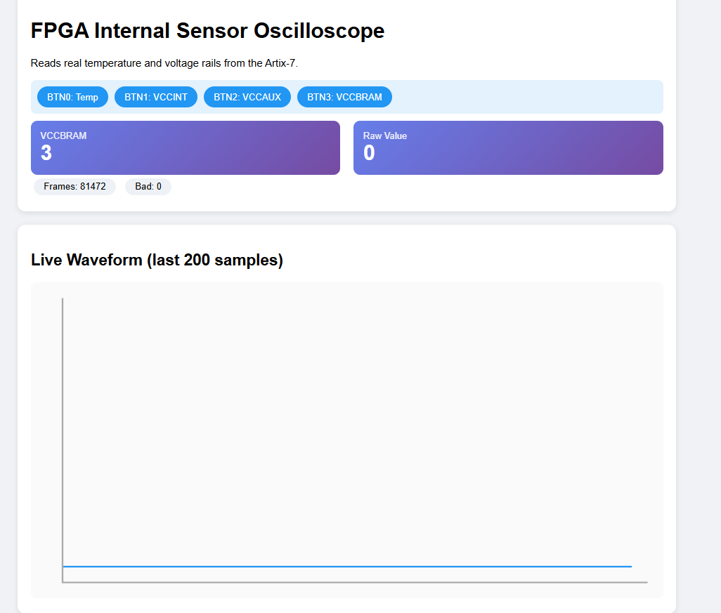

Slide 16
Thanks!
Do you have any questions?
I really hope not
Please keep this slide for attribution

